Slide 1

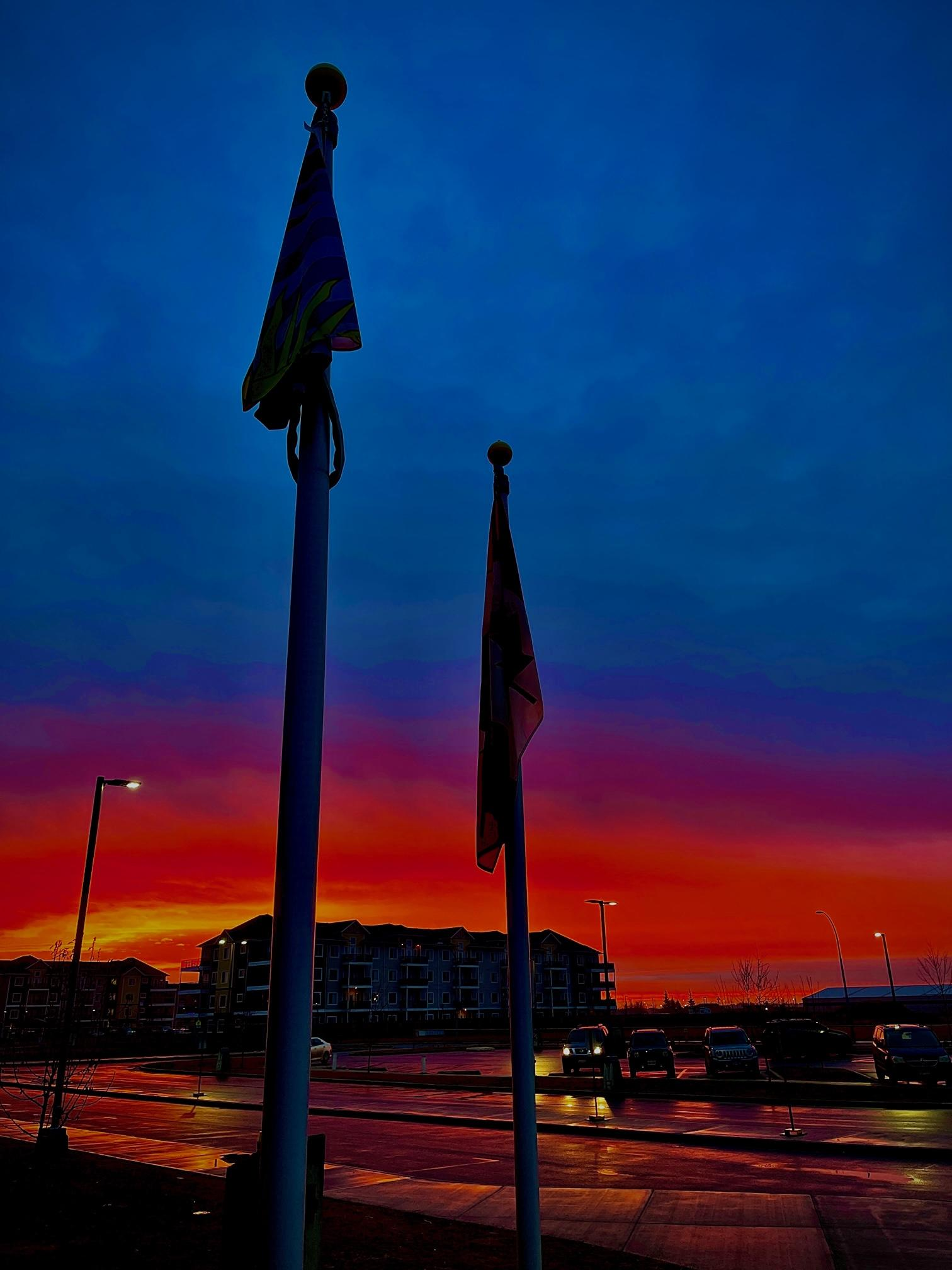
Remembrance Day Assembly
Here is the land, here is the sky. Here are my friends and here am I. We thank and acknowledge the Dene Zaa people on whose land we work and play and we promise to take care of it every day.
O Canada
Notes:
Welcome everyone -
Acknowledge we are meeting, living and learning on the traditional territory of the Dene Zaa territory

Slide 2
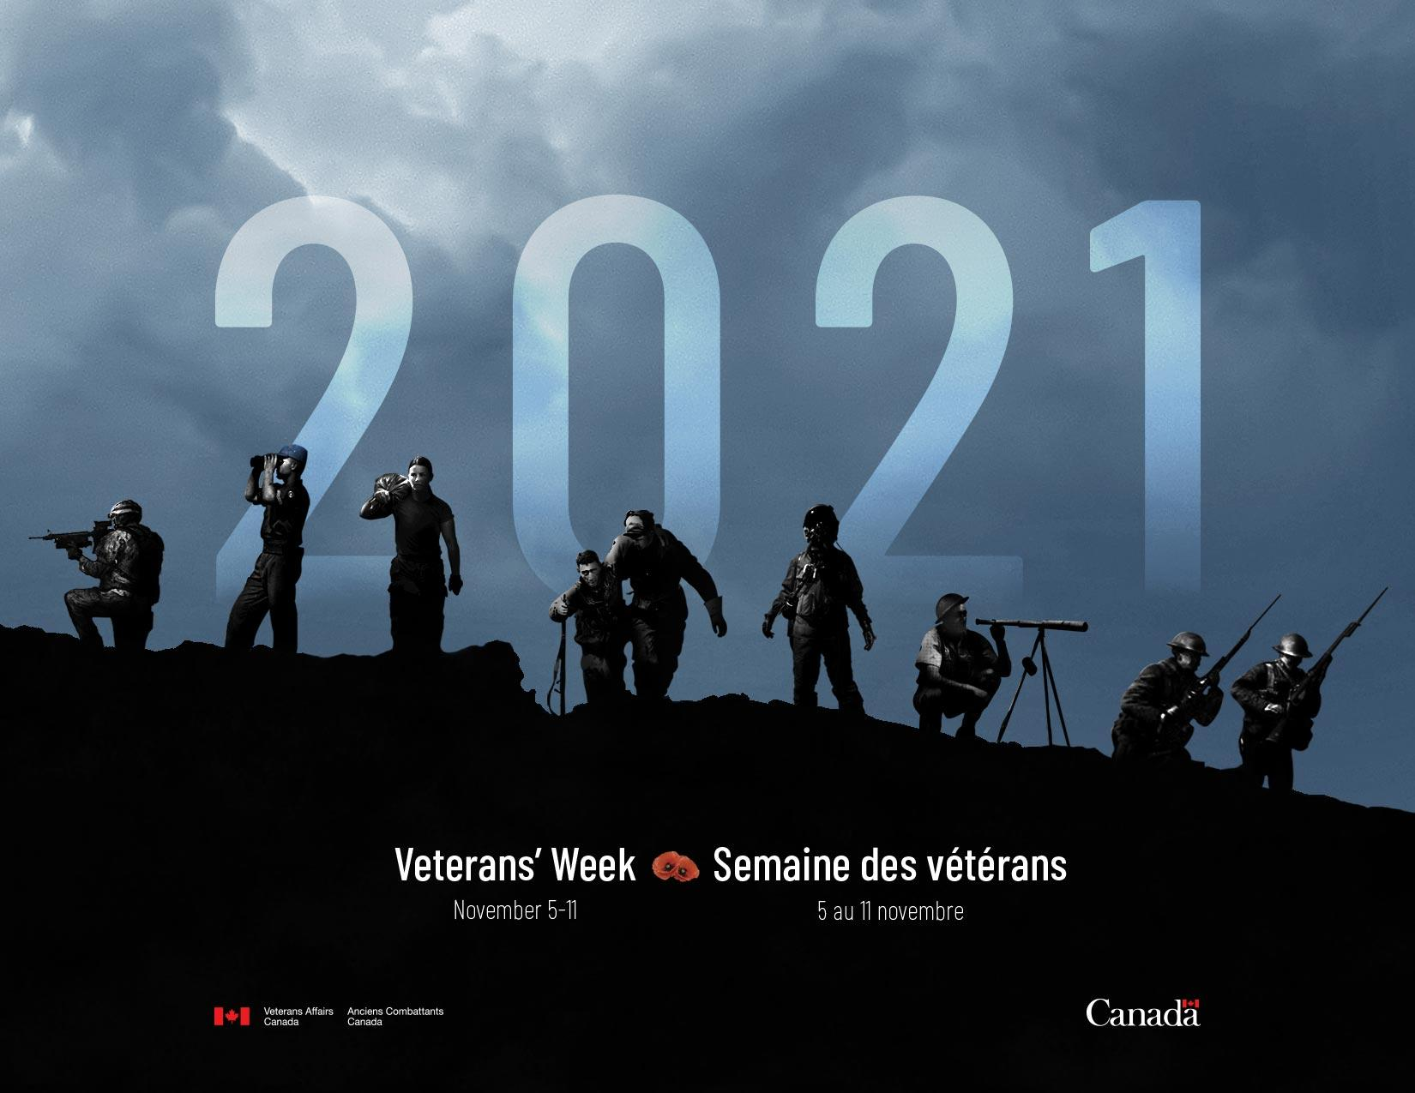
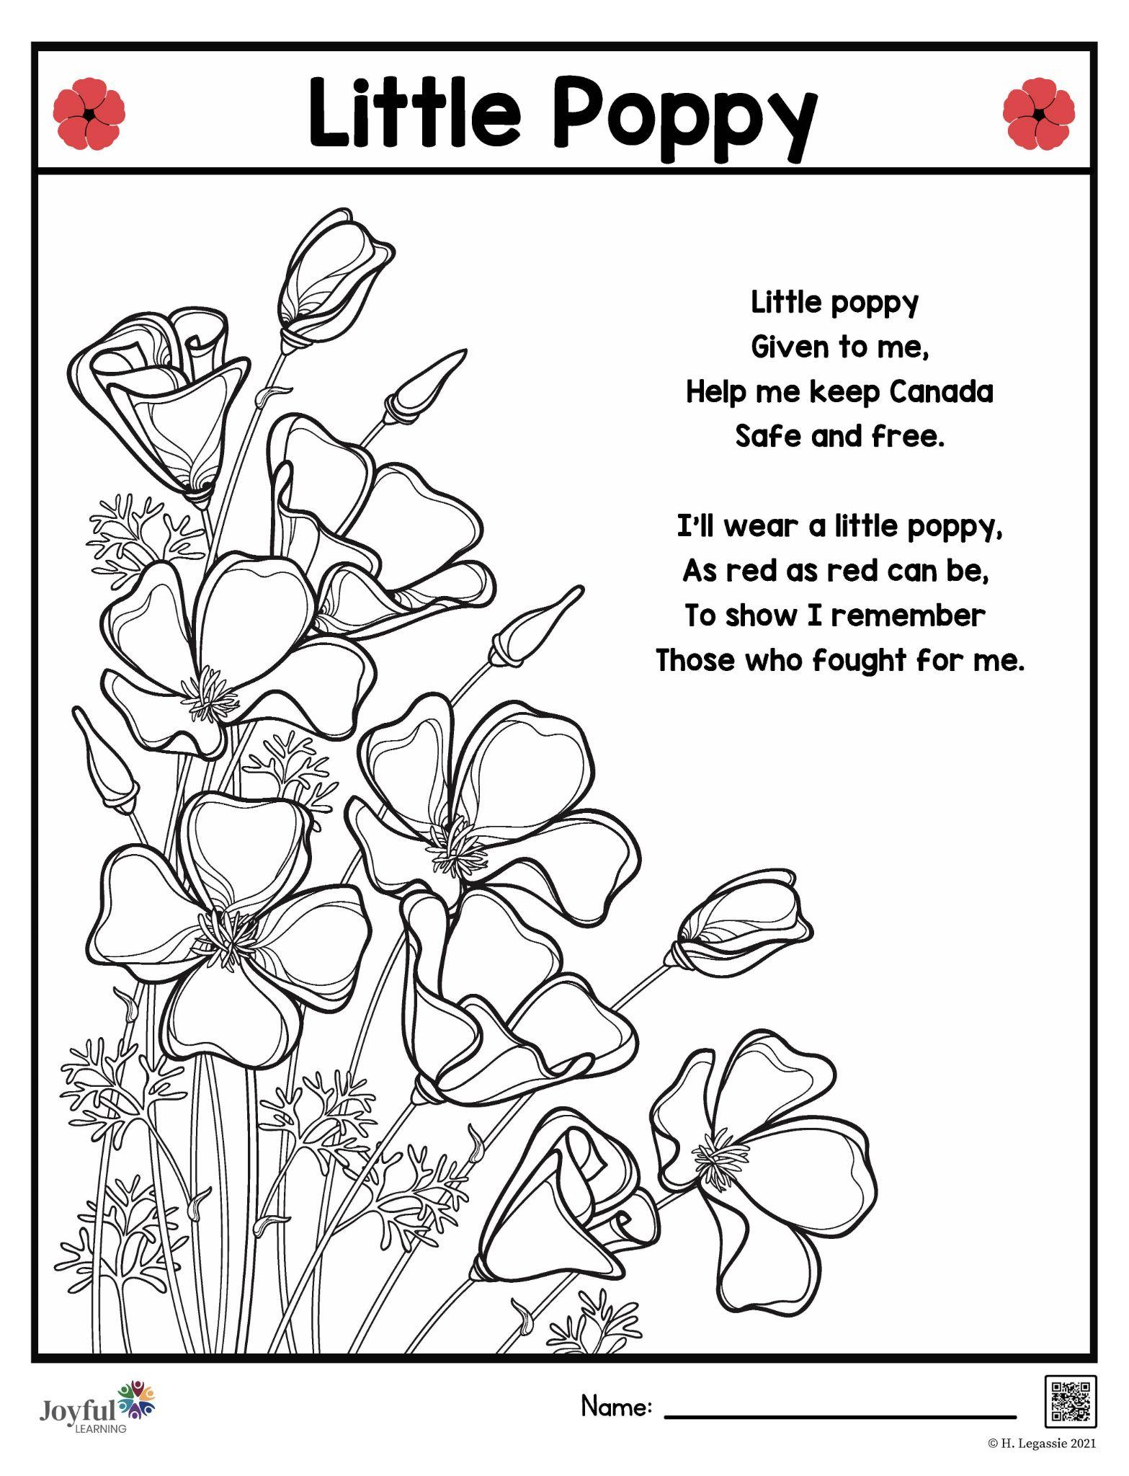
Remembrance Day Assembly
105 Years of Remembering
Why We Remember
Why We Wear Poppies
A Poppy is to Remember
Notes:
To staff: 105th year since November 11, 1918, at 11 a.m. wearing poppies as a sign of Remembrance since 1919
We will use the bolded links during the presentation today and you can use the other links at your discretion
We will ask Miss Jesperson’s class to recite Little Poppy

Slide 3
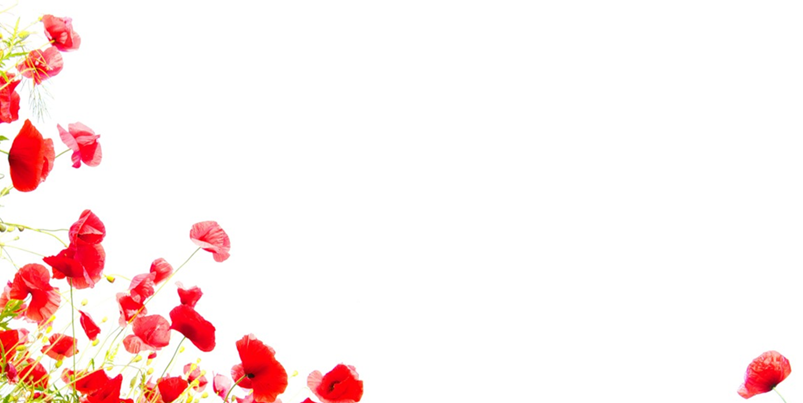
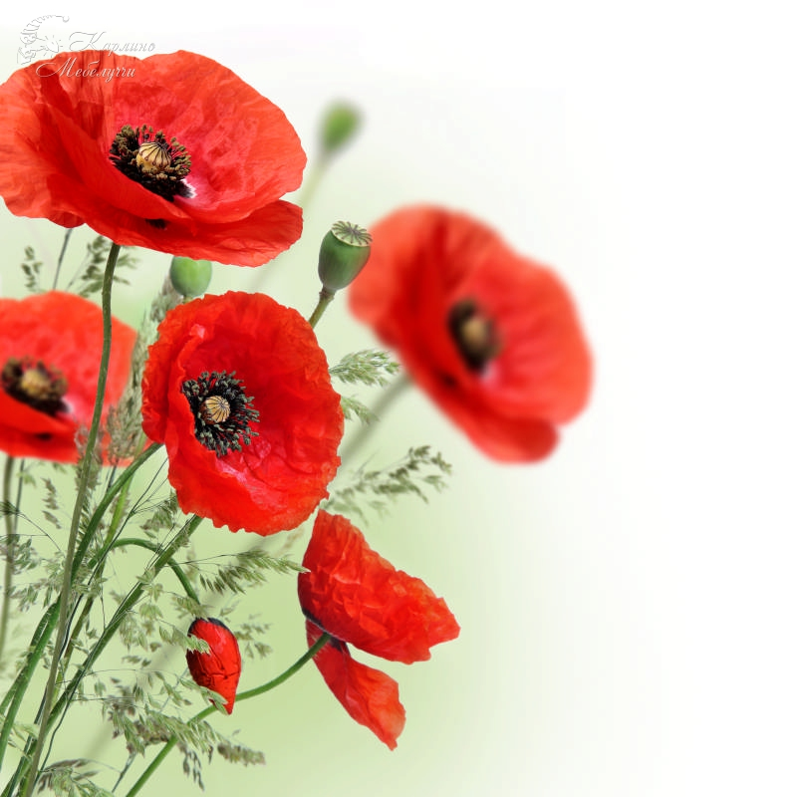
Today Remembrance Day is time to honour all of those who've served; the people that we know and the people we never met. It's a time to celebrate peace and honour courage
Notes:
Mrs. Kalas’ class will join us on the stage

Slide 4
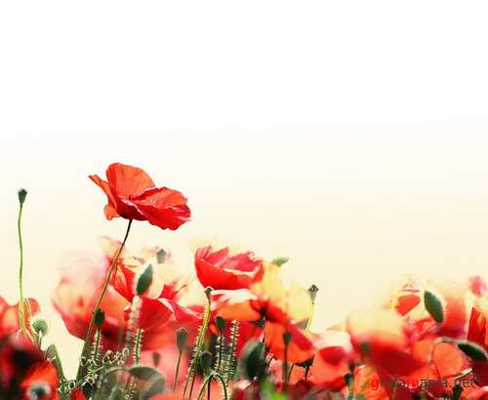
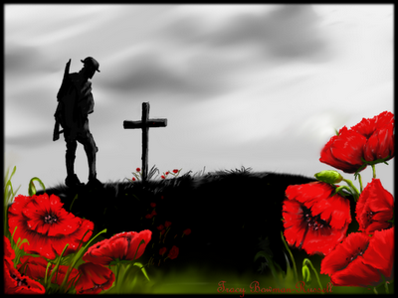
The eleventh hour of the eleventh day of the eleventh month in 1918 marked the signing of the armistice, which signaled the end of World War One after more than four years of continuous warfare.
Notes:
Miss Jesperson’s class will join us on the stage

Slide 5
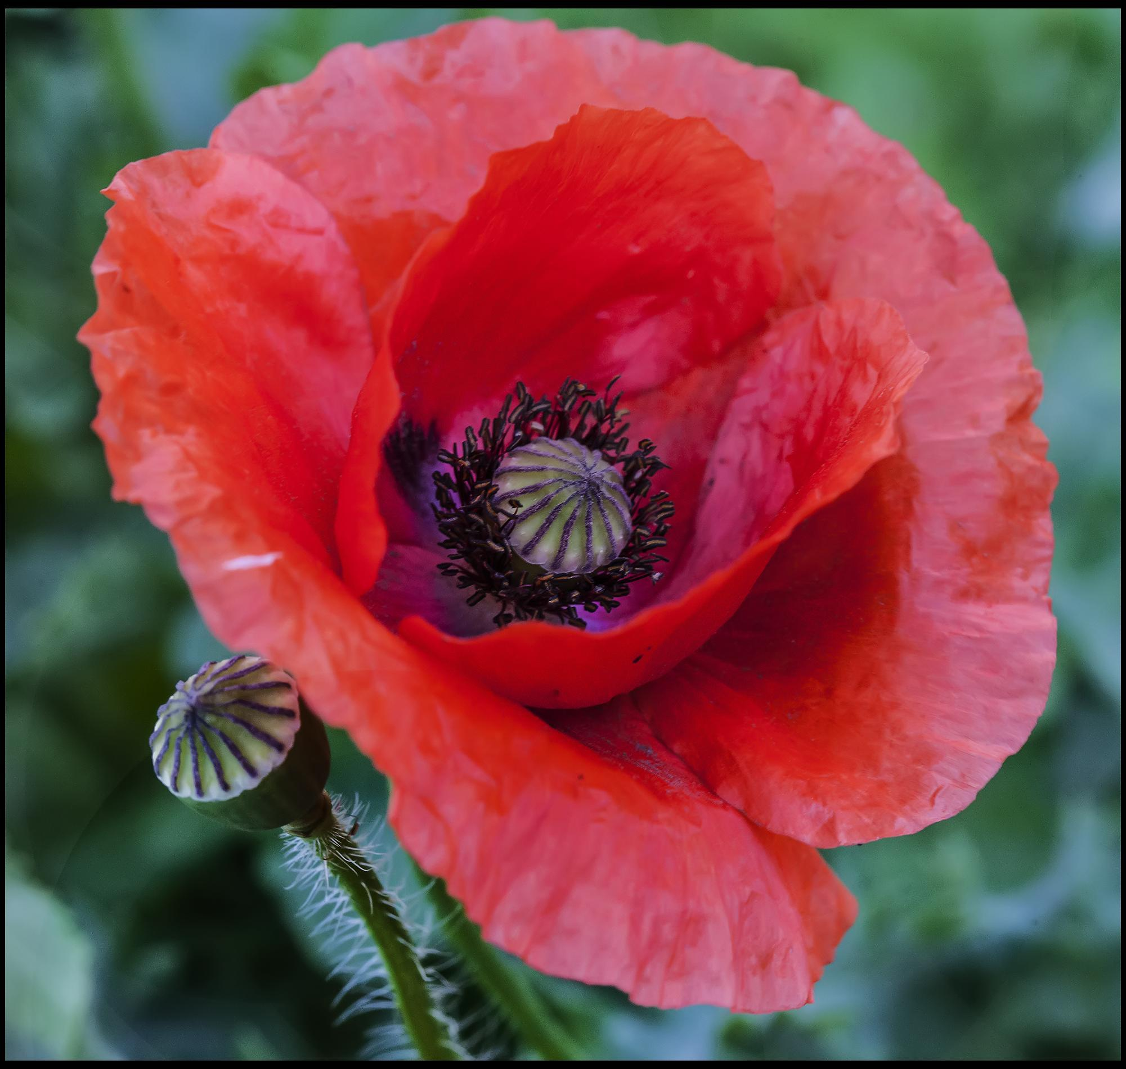
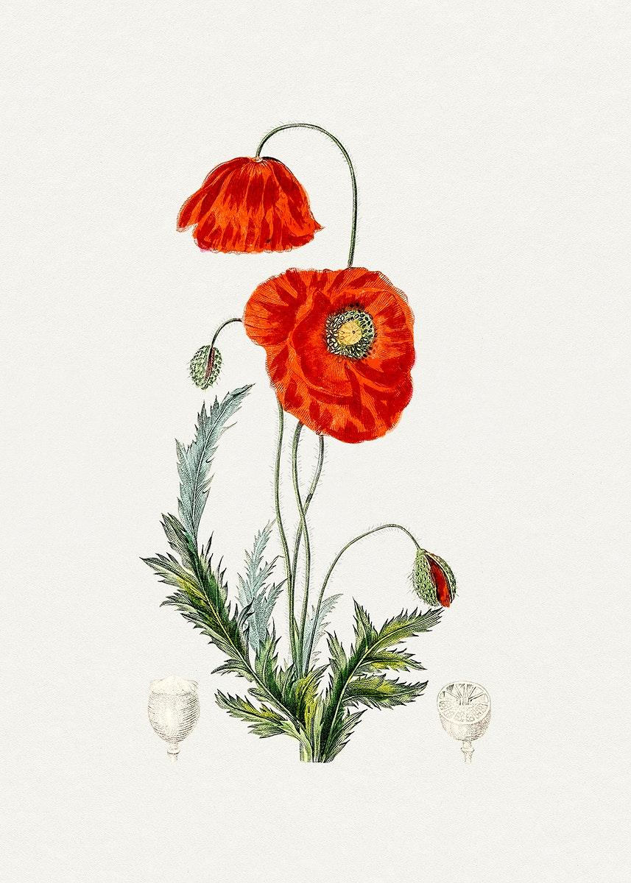
TheLegion
The First Poppy
Notes:
Poppies are very significant in showing our respect for the soldiers who have died in war:
Kindergarten reciting poem Poppy Poppy
Please join Mrs. Brooks in singing “Poppies”

Slide 6
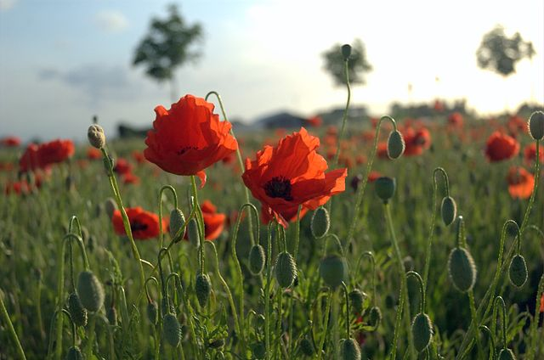
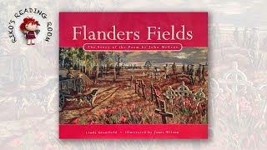
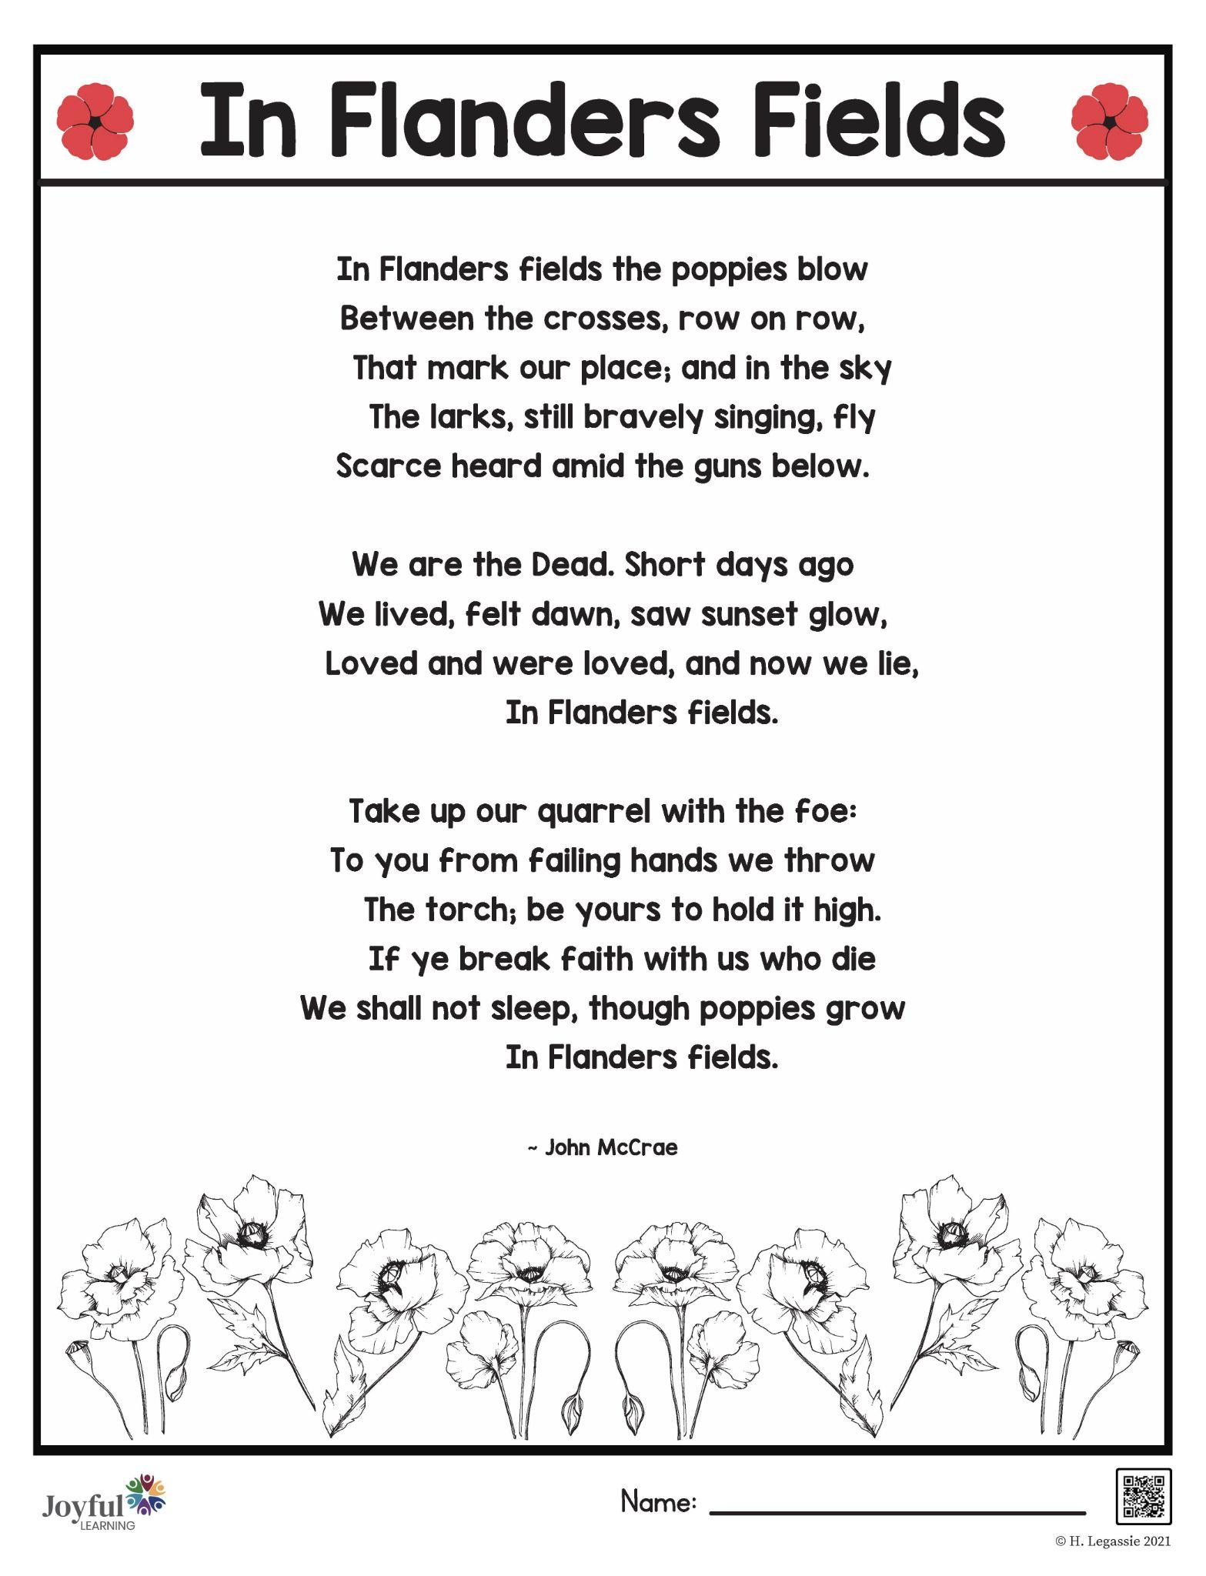
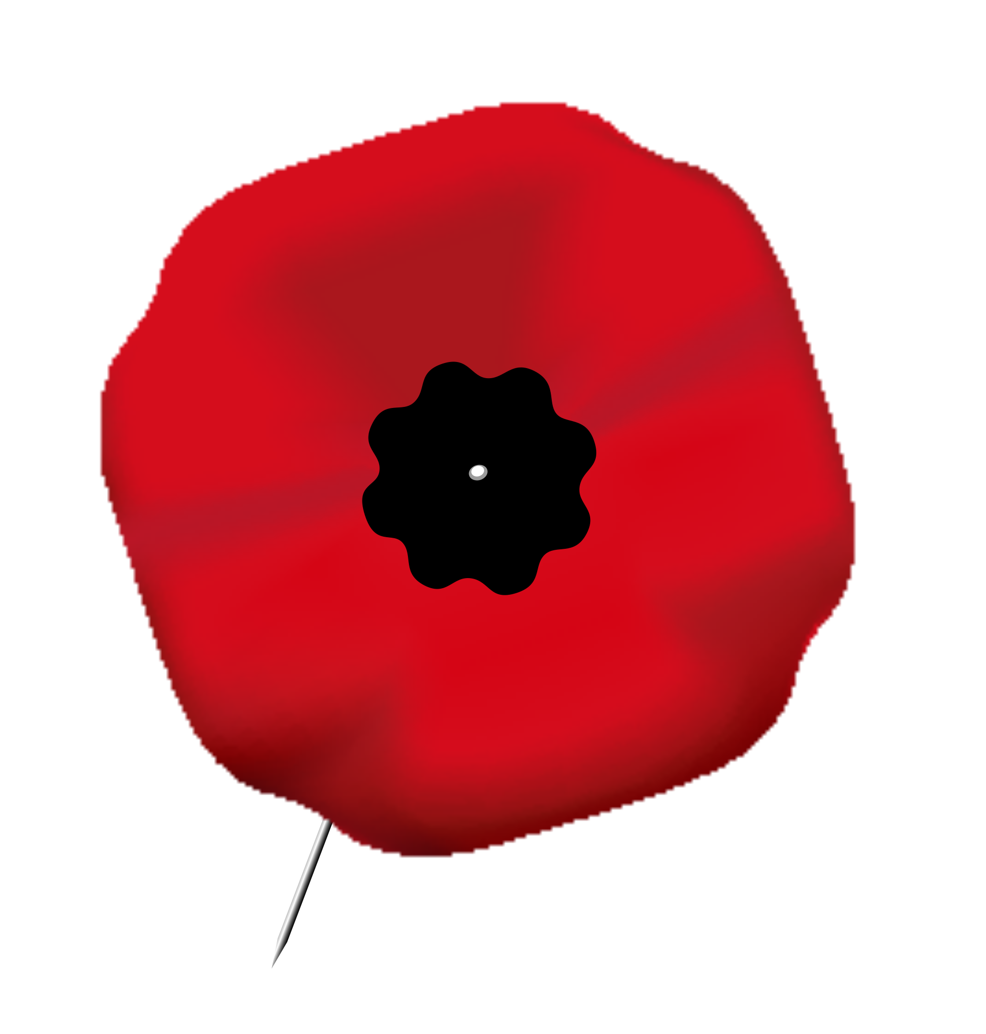
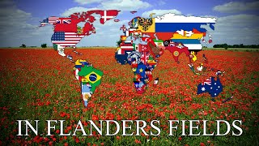
In Flanders Fields
In Flanders Fields
Notes:
Grade 5/6 students come to read to us In Flanders Fields listen to the song afterwards

Slide 7
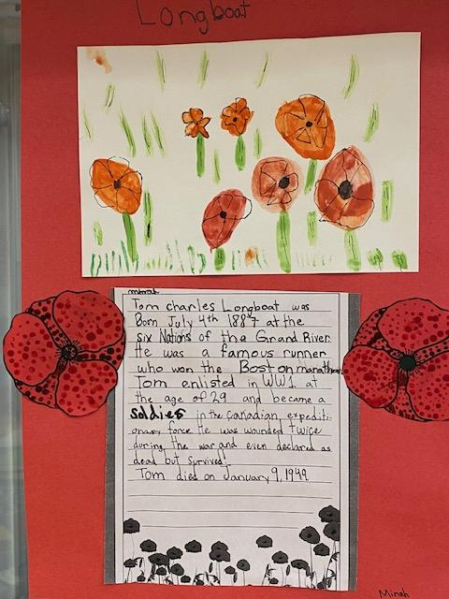
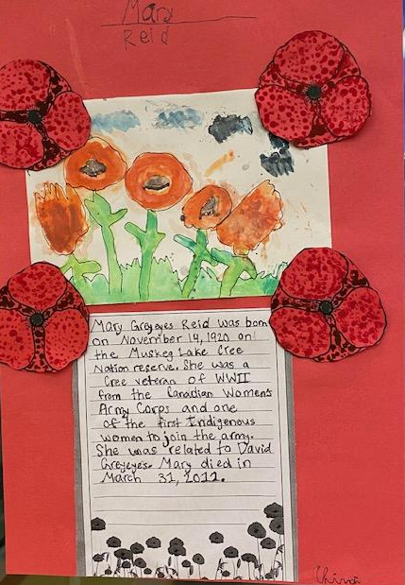
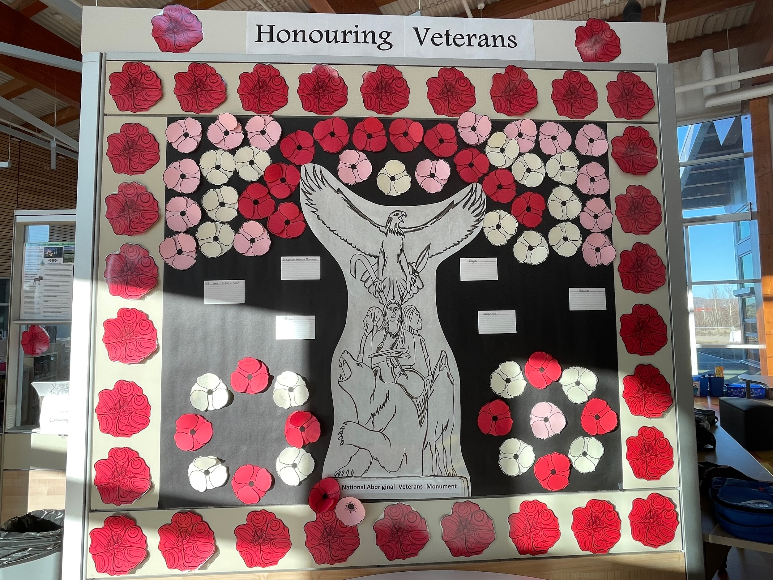
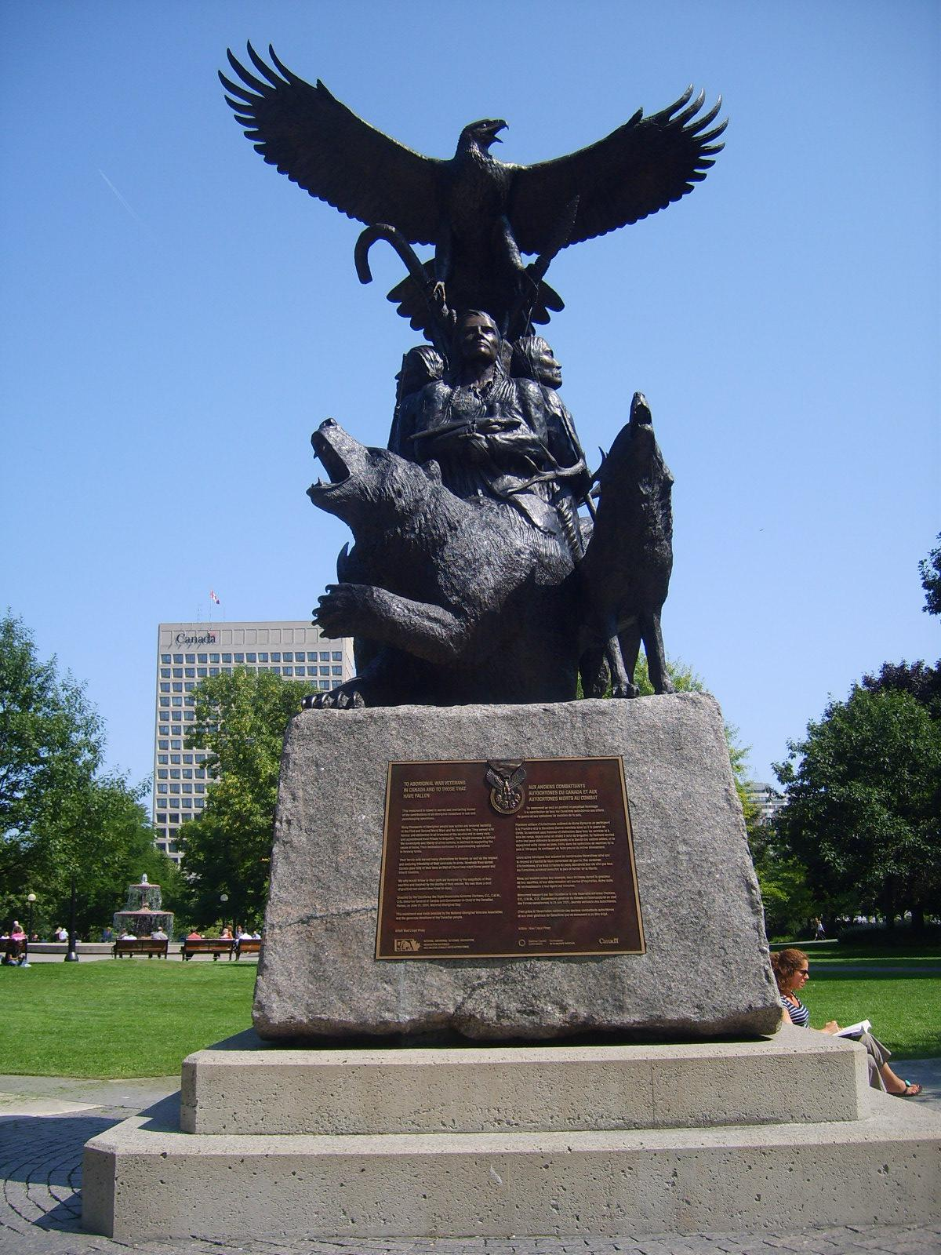
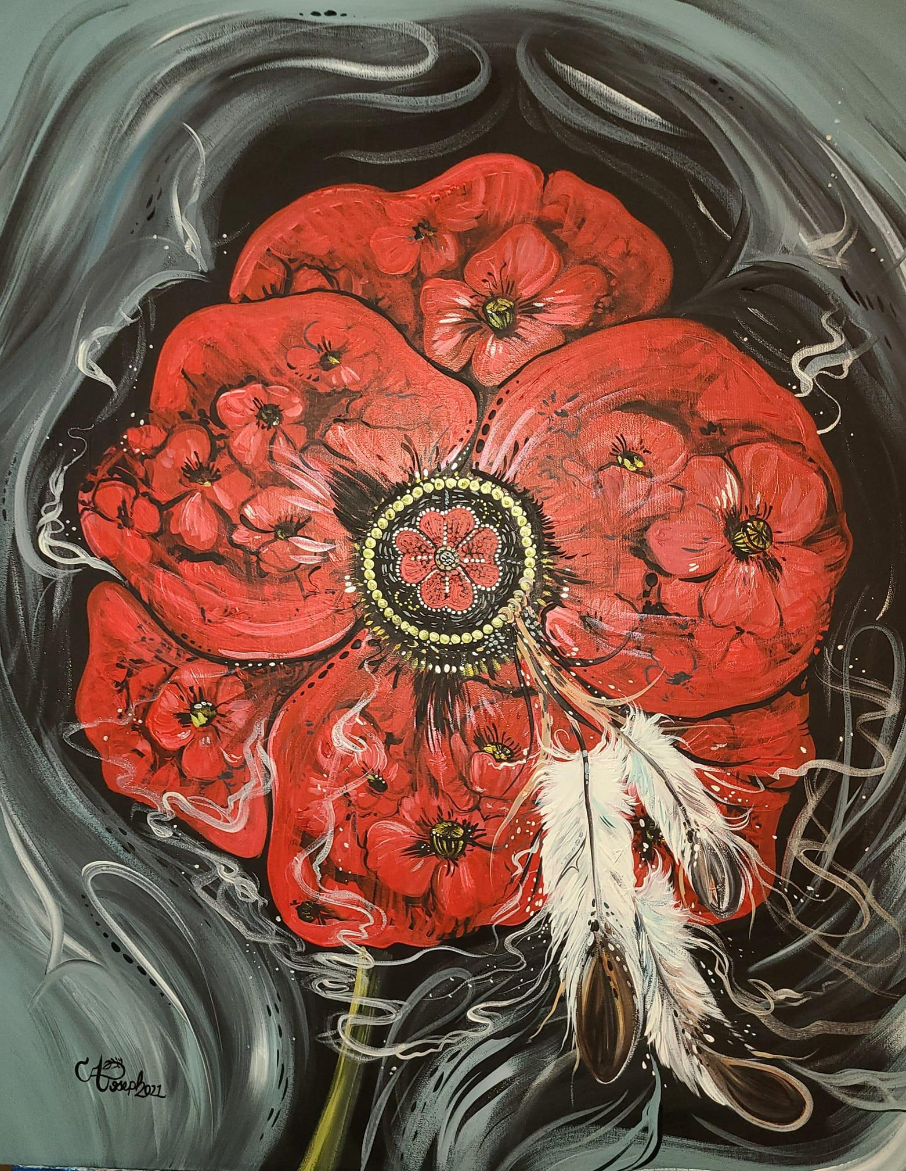
Indigenous Veterans’ Day November 8th
Indigenous Monument
Notes:
Mrs. Brittany worked with grade ⅚ students to learn about the Indigenous Veterans Monument This year marks the 20th anniversary of this monument. The monument has four animals around the base which represents spirit animals in indigenous culture The bear, the wolf, the elk and the buffalo. Four people two men and two women are facing the four direction representing the diversity of first nations, metis and inuit people. Two medicines and two weapons are in the monument representing the balance between peace and war. The Eagle at the top represents the creator and embodies the spirit of indigneous peoples.

Slide 8
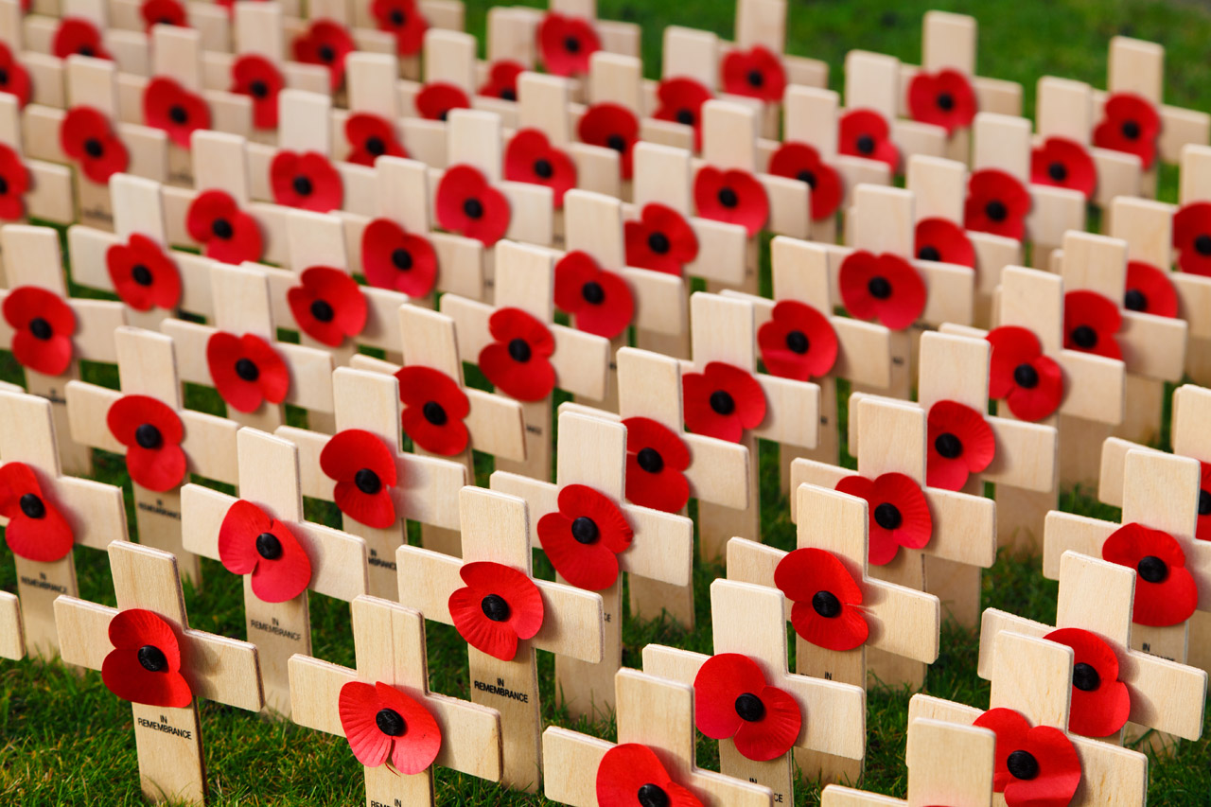
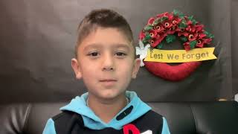
Notes:
Mrs. Powers’ class has prepared a video for us

Slide 9
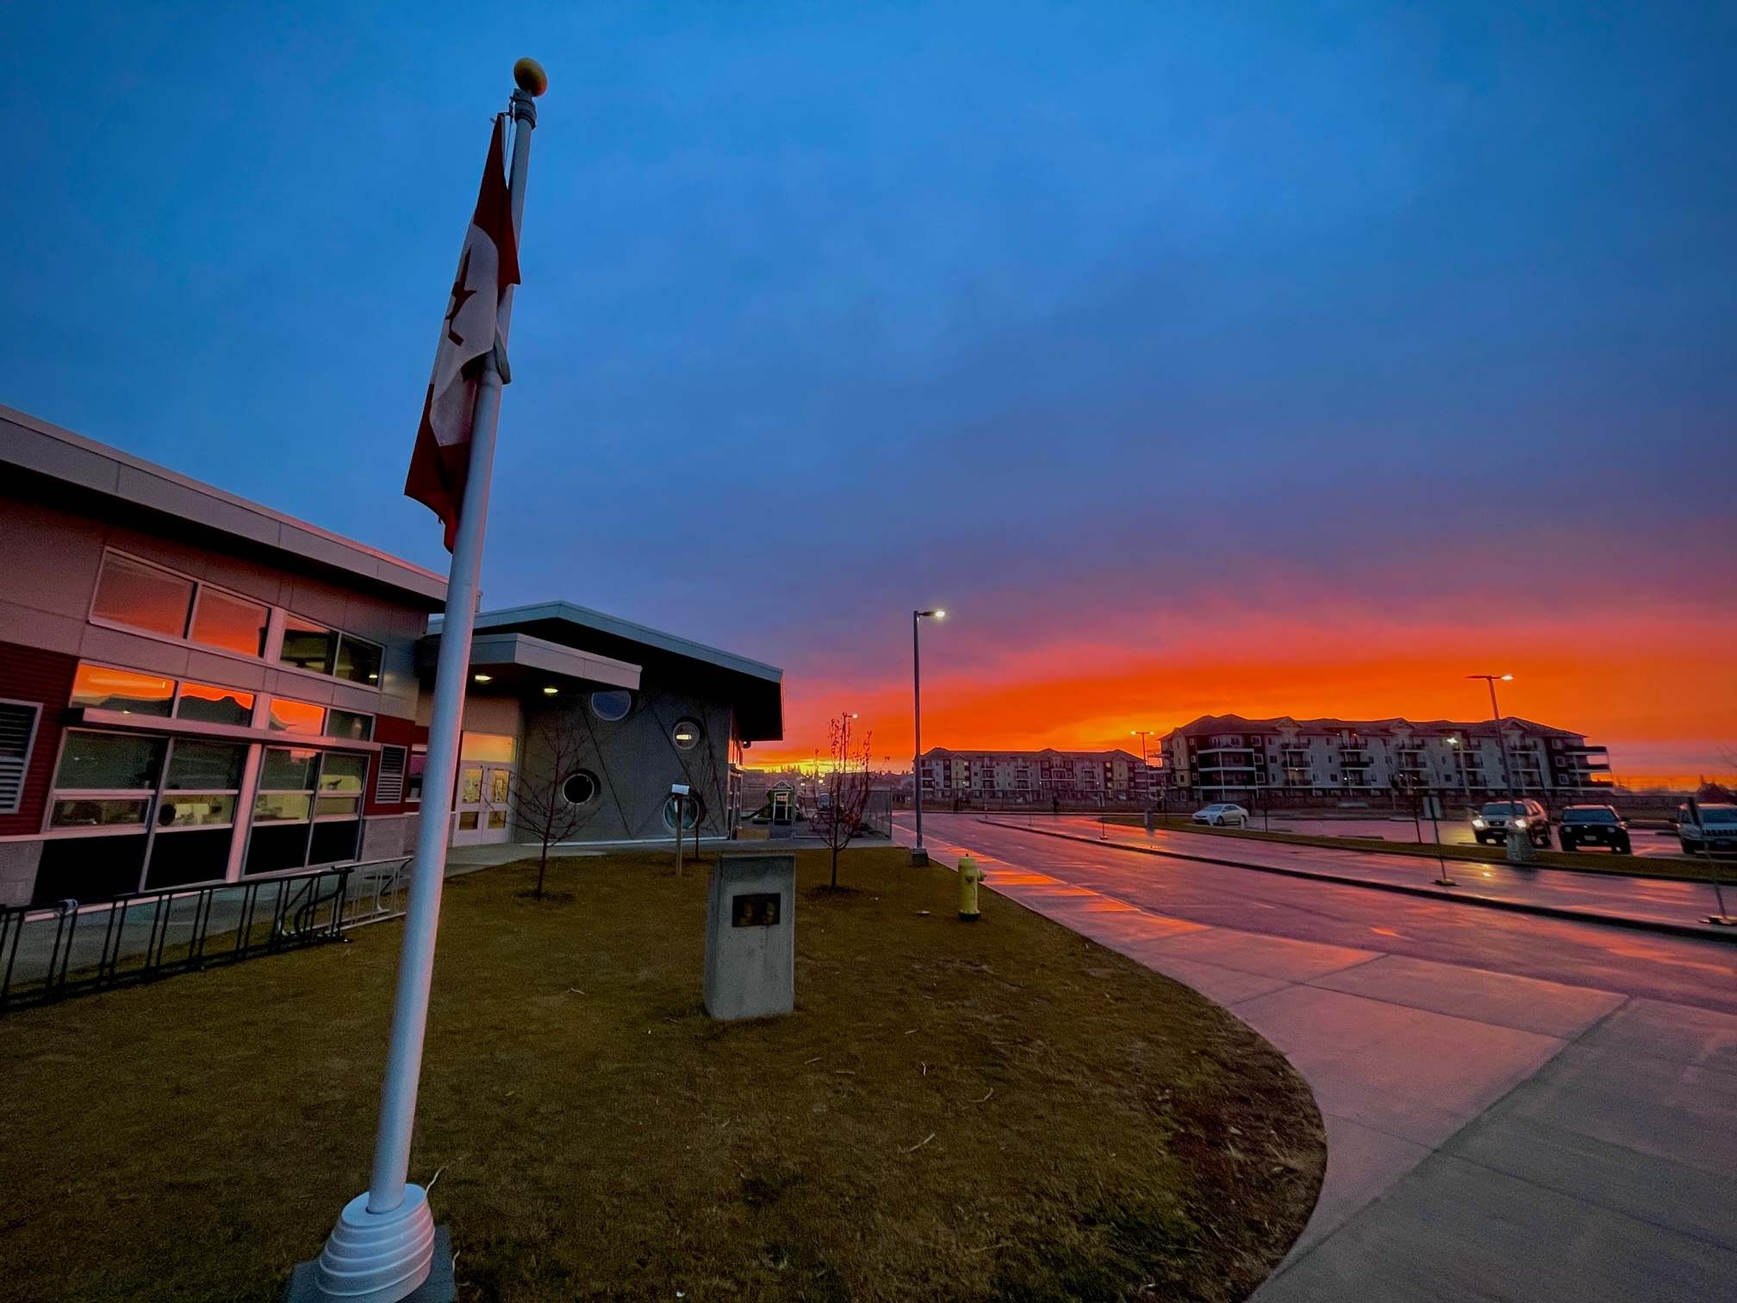
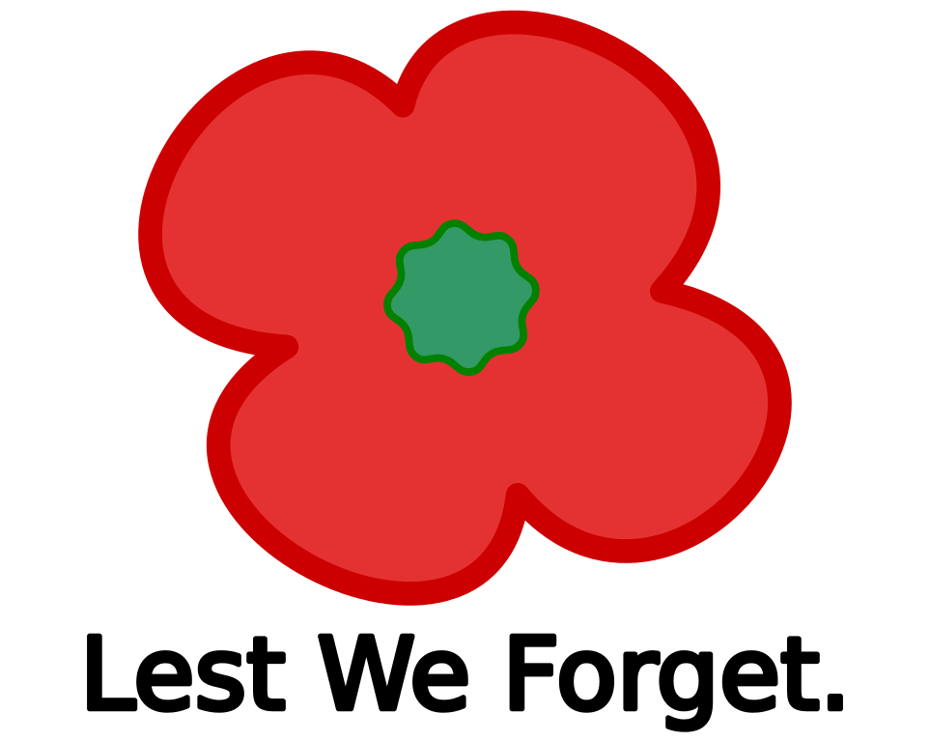
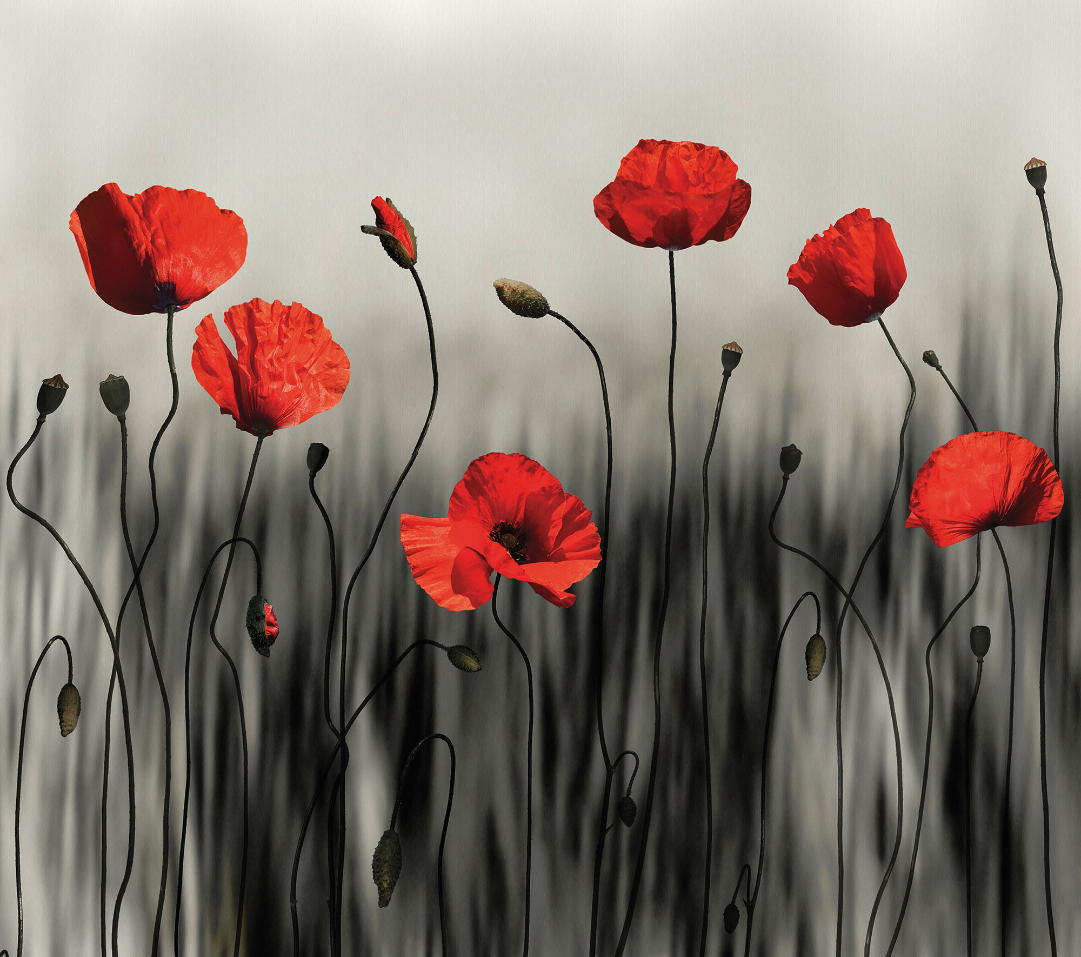
A Pittance of Time
The Last Post and Reveille
Highway of Heroes
The Last Post
2 Minutes of Silence | A Remembrance Day Vignette
Notes:
Closing: Two short videos with 2 minutes of silence
That concludes our service today - teachers may access other videos after the presentation and use in the afternoon if they wish

Slide 10

