Slide 1
Adolescent Use of Social Media in School District 60 Peace River North
** Dissertation Proposal in Fulfillment of the University of Kansas Doctorate of Education Program

Slide 2
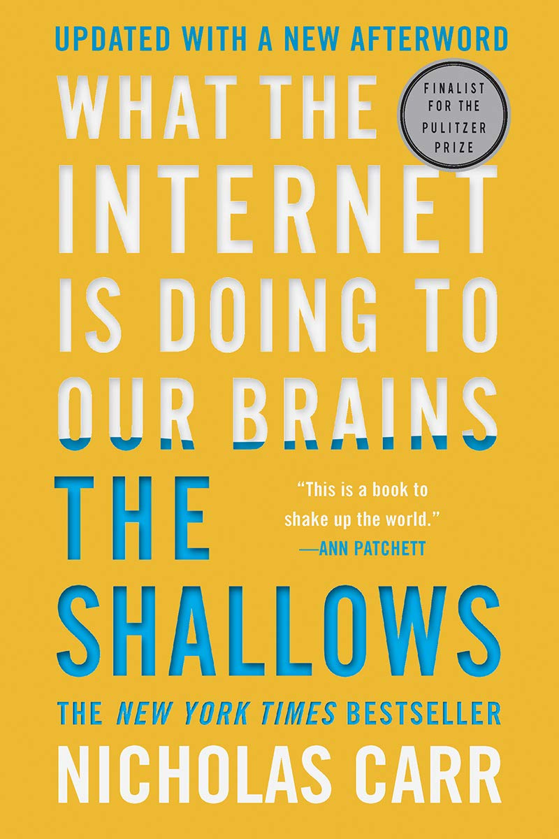
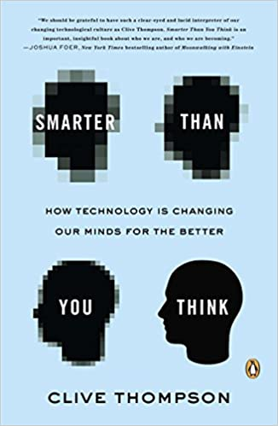
Background / Inspiration
Kranzberg’s First Law:
“Technology is neither good nor bad, nor is it neutral”. (Kranzberg, 1991)
Notes:
A dichotomy of research and opinion when it comes to the benefits and drawbacks of being online

Slide 3
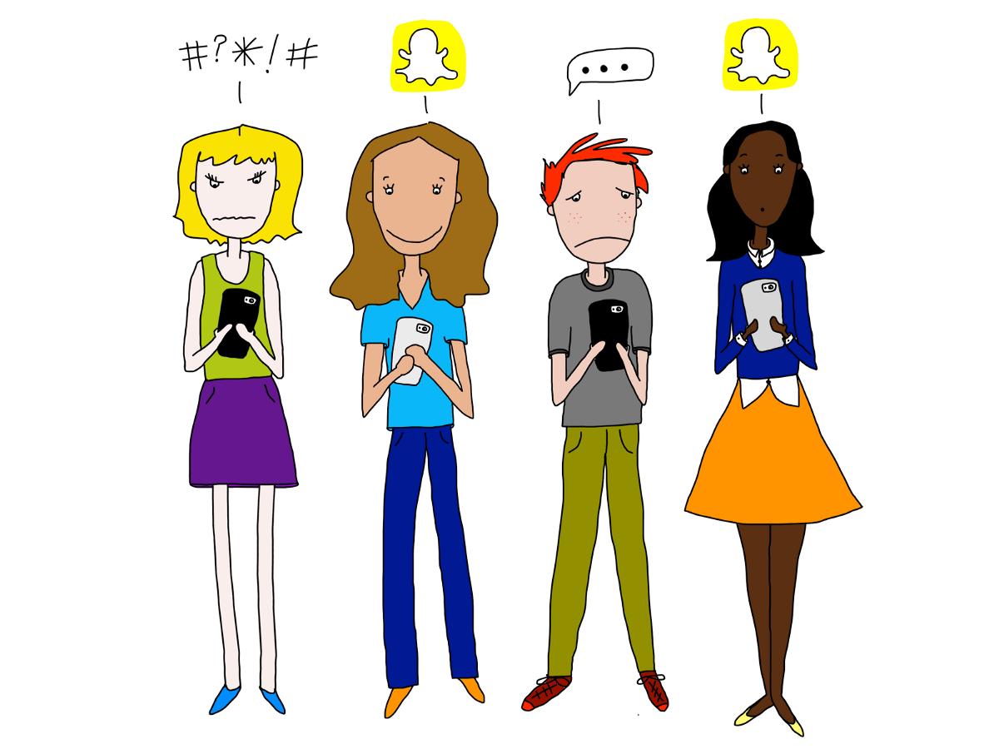
The Problem
Adolescents spend a significant and increasing amount of time online, especially on social media platforms where some teens check their profiles up to three hundred times a day (Anderson & Jiang, 2018; Martin et al., 2018; Twenge et al., 2019)

Slide 4
The Research Questions
In what ways and on which platforms do adolescents in School District 60 currently interact with Social Media?
What effects do these adolescents say that social media has on people their age - mostly positive, mostly negative or neither positive nor negative. What reasons do they give?
How does the use of Social Media and its perceived effects in this particular population differ by age, gender, ethnicity and socioeconomic status?

Slide 5
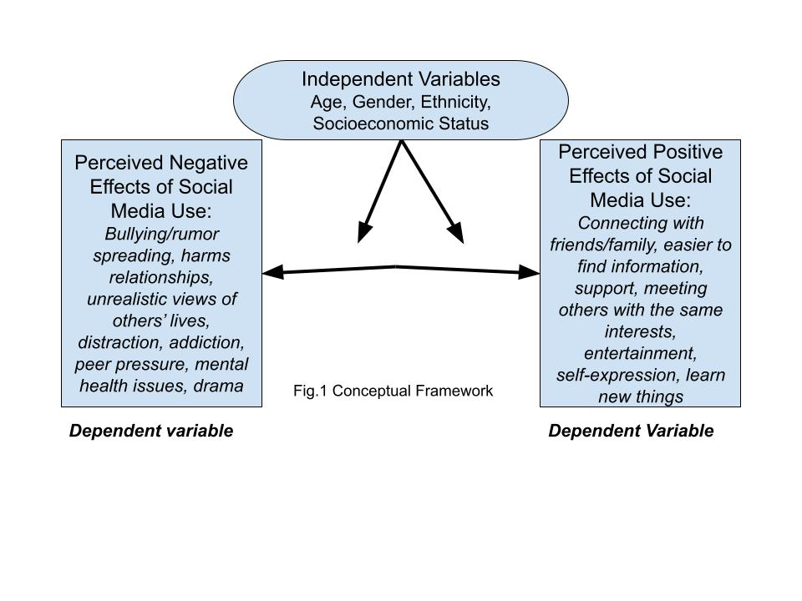
Conceptual Framework

Slide 6
The Research
Adolescent Cognitive Development & the Corporate Ethos of Social Media
How Adolescents Interact with Social Media
Research on the Positive Effects of Social Media Use
Research on the Negative Effects of Social Media Use
** Research on variations by demographic variables of age, gender, ethnicity and SES where applicable

Slide 7
The Methodology: A Descriptive Study
Q1: How Teens Use Social Media (SM)
Descriptive stats and graphs for one variable - ie. most popular SM sites
Q2: Perceived positive and negative effects of SM use
Descriptive stats and graphs for one variable - ie. Does SM use make you feel included or excluded?
Q3: Variations in responses by demographic/independent variables
Descriptive stats and graphs of study population
Stats and graphs for 2 or more categorical variables
Notes:
Frequency, percentages, measures of central tendency

Slide 8
Q3: Potential Relationships Between Independent & Dependent Variables
Unordered categorical variables - nominal scale data
Cross-tab independent variables with each dependent variable with the main emphasis on questions related to perceived positive & negative effects of SM use - as per the conceptual framework
Similarities and differences between this study and the 2018 PEW study

Slide 9
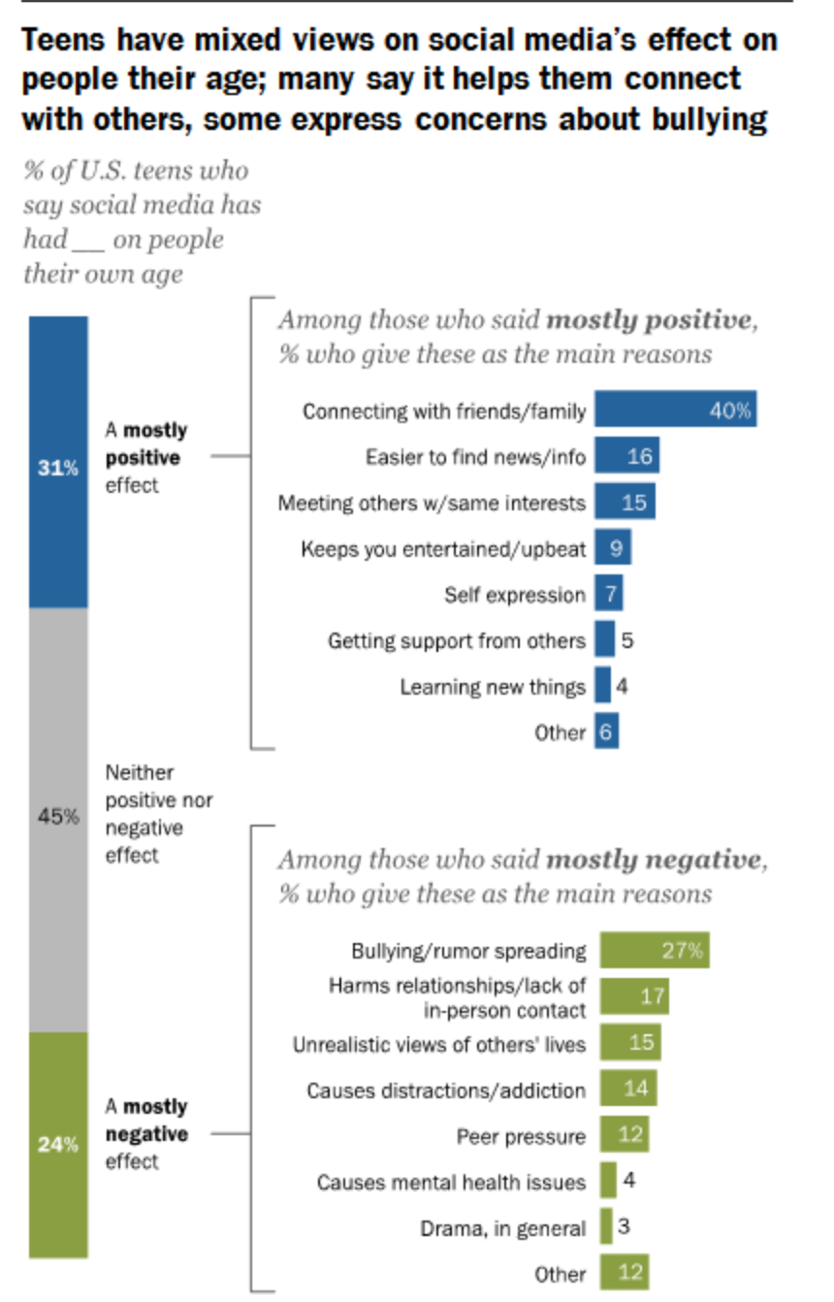
2018 PEW Teen Survey (Anderson & Jiang, 2018)

Slide 10
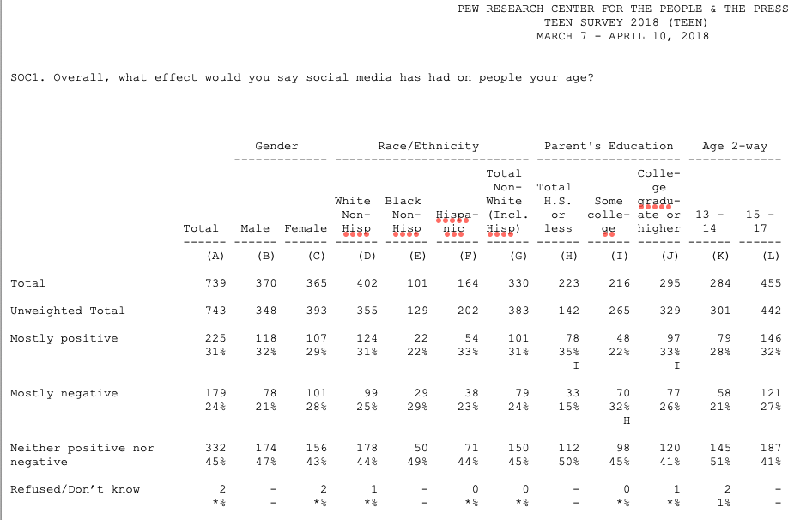

Slide 11
The Survey

Slide 12
The Significance of this Study
Up-to-date research on how adolescents use social media - the trends and patterns related to choice of platforms, time online and behaviors online
A BC perspective on how Indigenous adolescents use social media
Current insights into adolescent perspectives on the positive and negative effects of social media use
Information that educators and system leaders can use to engage and support adolescents in their education

